Slide 1
MECE 3245
Materials Science Lab
Lecture 1: Tensile and Fatigue
Department of Mechanical Engineering
University of Houston

Slide 2
Overview
Tensile test
  Stress and strain
  Deformation
  Stress-strain curve
    Deformation
    Strength values
    Ductility
    Toughness
Fatigue test
  S – N curve

Slide 3
Stress and Strain
F
F
Stress conditions
  Tensile
  Torsion (shear)
  Compression
  Biaxial stress
  Hydrostatic stress
Stress
  Unit
    Pa (N/m²)
    psi (lb_{f}/in²)
  Tensile and compressive stress
    F and σ > 0 for tensile
    F and σ < 0 for compressive
Strain
  Deformation in response to stress (force)
  Engineering (tensile) strain
    Dimensionless
A
o
= cross sectional
area (when unloaded)
F
σ
=
σ
σ
A
o
L -L_{o}
ε
=
δ
/2
L
o
δ
L
ε
=
w
o
o
L
o
δ
L
/2

Slide 4
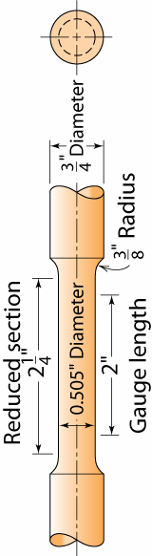
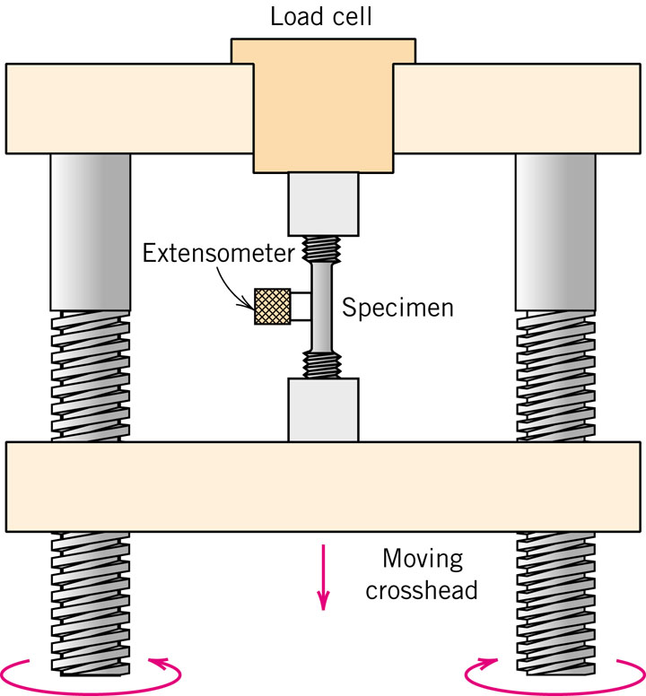
Stress-Strain Test (Tensile Test)
Typical tensile test
• Typical specimen
gauge

Slide 5
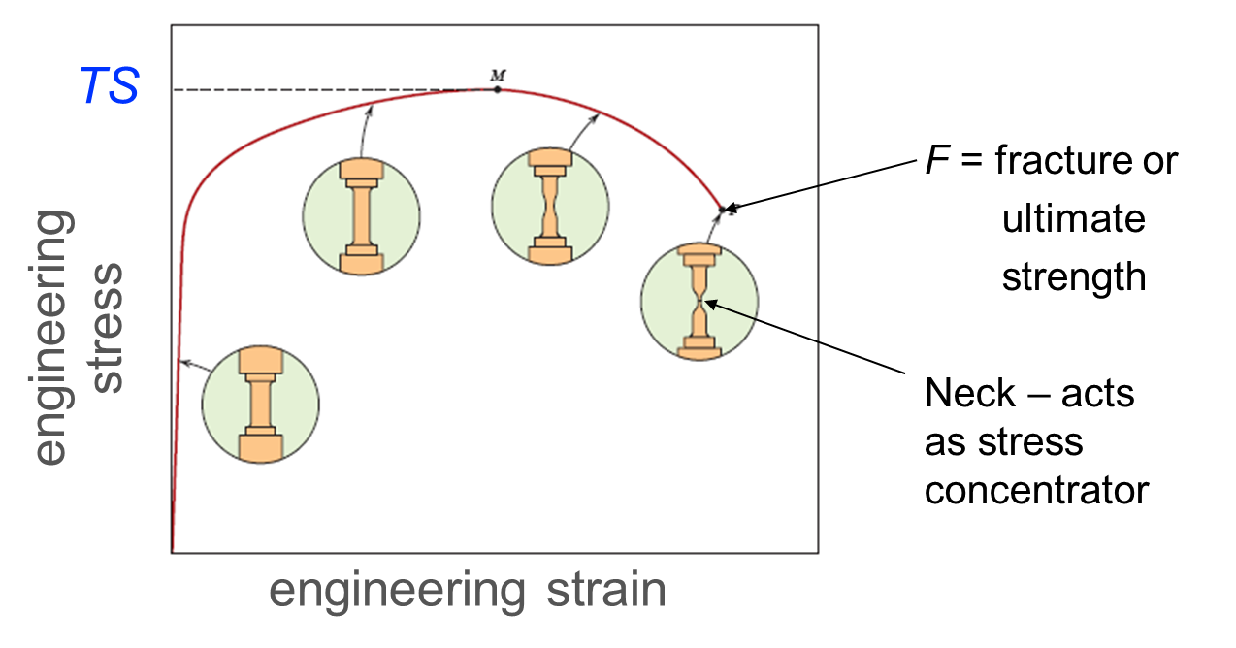
Engineering Stress-Strain Curve
Tensile stress (TS)
Fracture stress (ultimate strength) (FS)

Slide 6
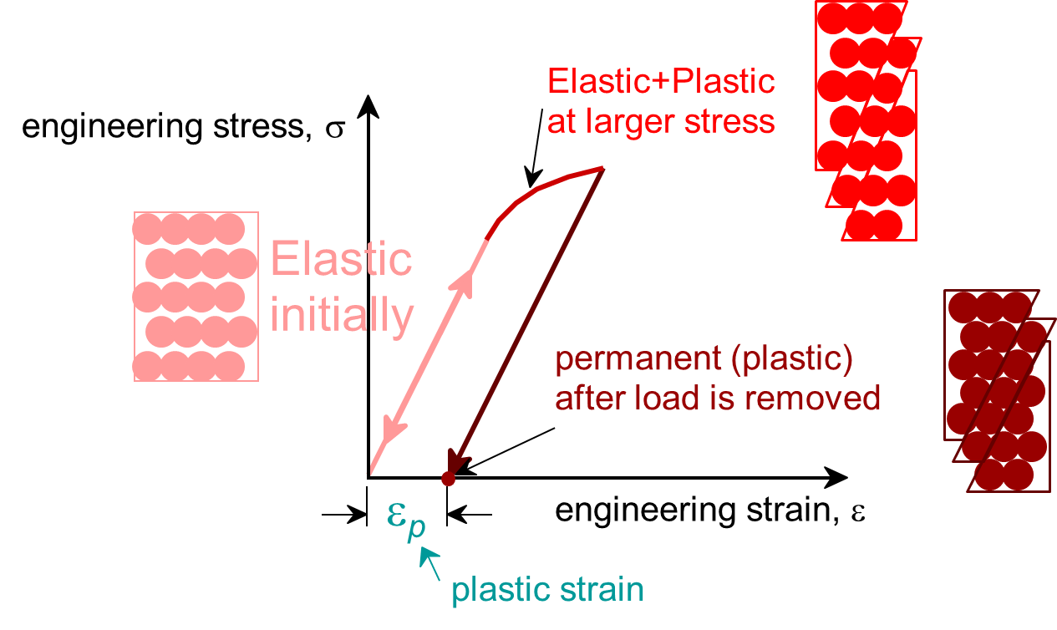
Deformation
Deformation
  Elastic deformation
    Bond stretch
    Reversible process
  Plastic deformation
    Slip of atomic planes
    Permanent change
Fracture

Slide 7
Elastic Deformation
1. Initial
2. Small load
3. Unload
bonds
stretch
return to
initial
δ
F
F
Linear-
elastic
Elastic means reversible!
Non-Linear-
elastic
δ

Slide 8
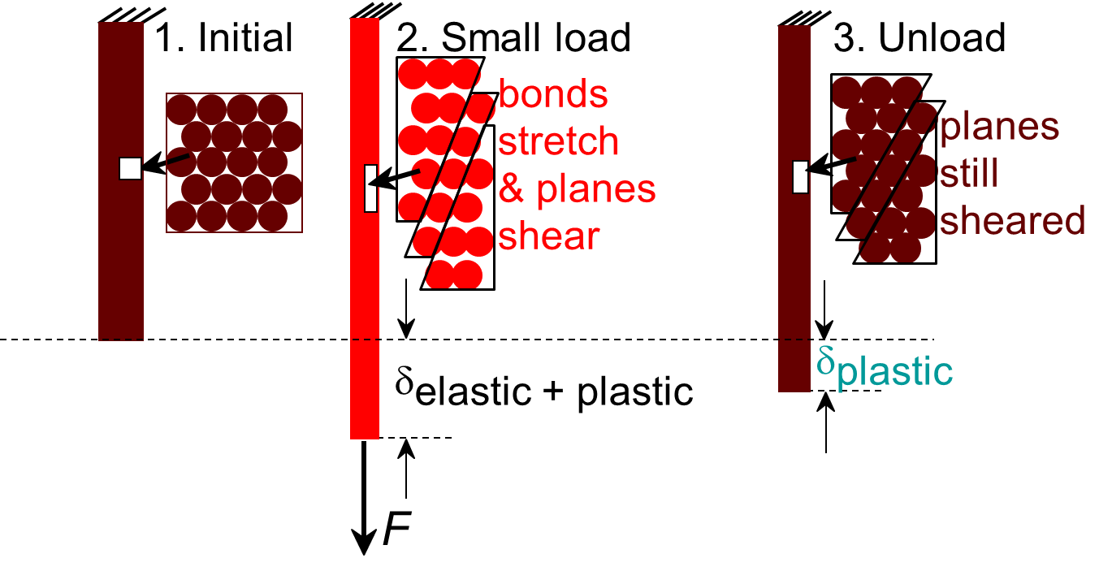
Plastic Deformation (Metals)
F
linear
linear
elastic
elastic
δ
Plastic means permanent!
δ
plastic

Slide 9
Yield Strength, σ_{y}
Stress of plastic deformation initiation
• Stress at which noticeable plastic deformation has
occurred.
tensile stress,
σ
when ε_{p} = 0.002
σ_{y}
σ_{y} = yield strength
Note: for 2 inch sample
ε = 0.002 = Δz/z
∴ Δz = 0.004 in
engineering strain,
ε
ε_{p}
= 0.002

Slide 10
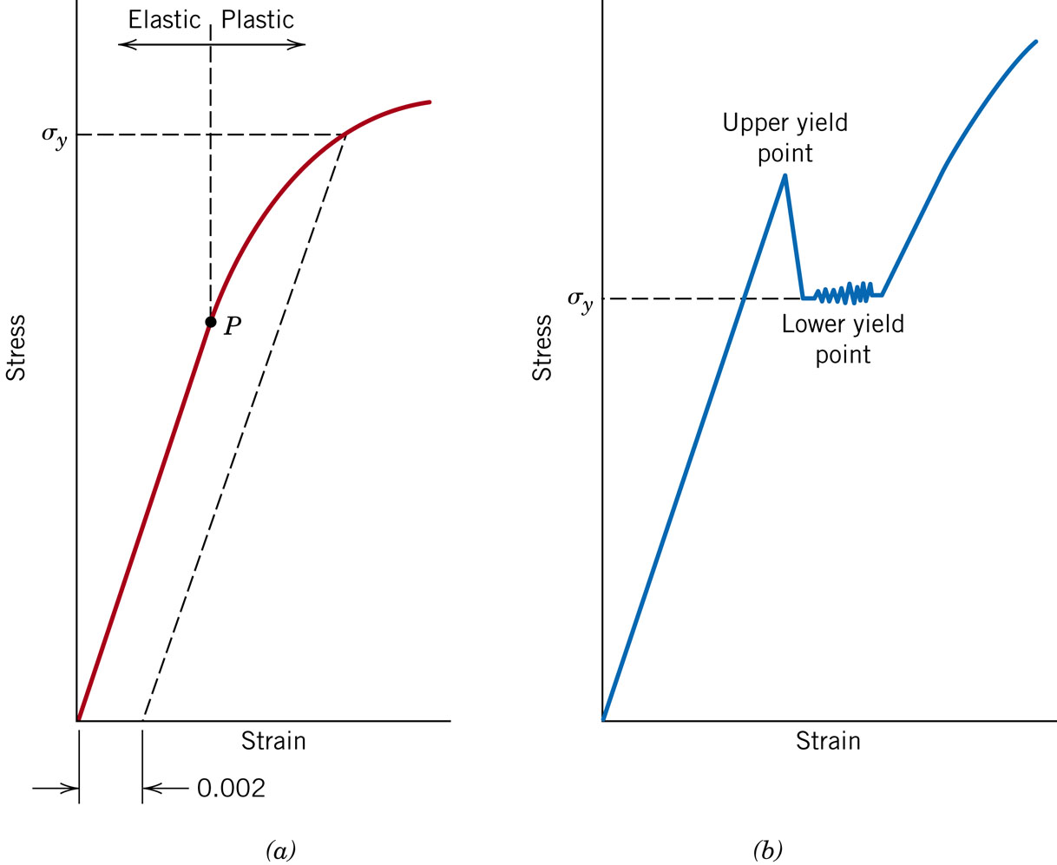
Yield Strength Determination Methods
Strain-offset method
Low-yield point (average)
  Some steels w/ Yield-point phenomenon

Slide 11
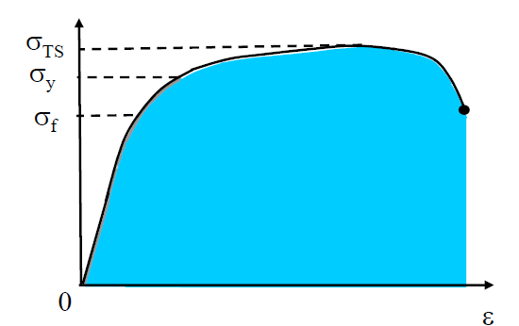
Engineering Stress-Strain Curve
Stress
  Yield stress: stress when plastic deformation begins
  Tensile stress: maximum stress in stress-strain curve
  Fracture stress: stress when fracture happens
Strain energy
  Toughness: strain energy stored per unit volume up to fracture point
  Resilience: strain energy stored per unit volume up to yielding point

Slide 12
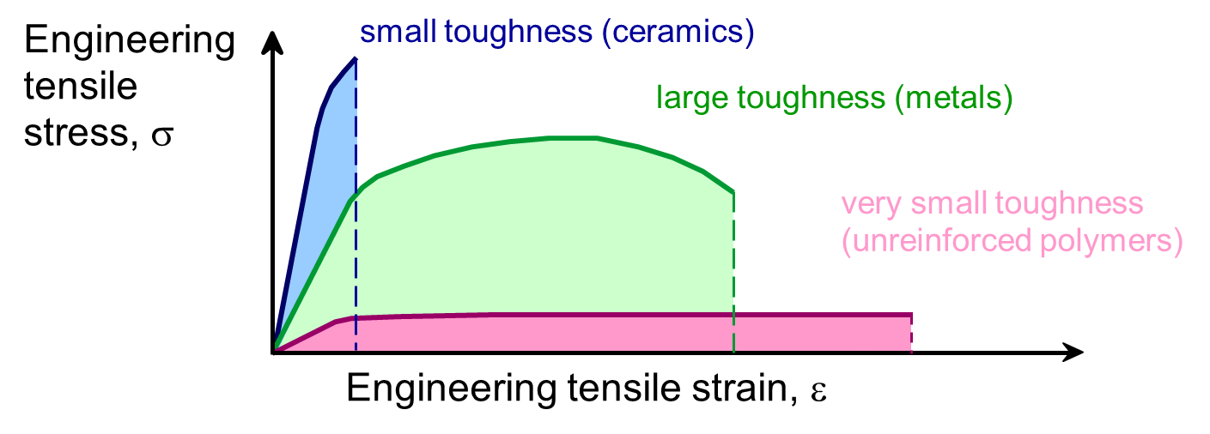
Elastic and Plastic Deformation Toughness
Toughness
  Energy to break a unit volume of material
  The area under the stress-strain curve

Slide 13
Elastic and Plastic Deformation
Ductility
Ductility
L
−
L
• Plastic tensile strain at failure:
%
EL
=
f
o
x 100
L
o
smaller %EL
E
ngineering
tensile
stress, σ
larger %EL
A_{o}
L_{o}
A_{f}
L_{f}
Engineering tensile strain, ε
A
-
A
• Another ductility measure:
=
o
f
%
RA
x
100
A
o

Slide 14
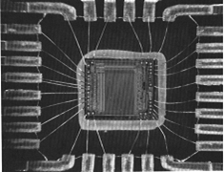

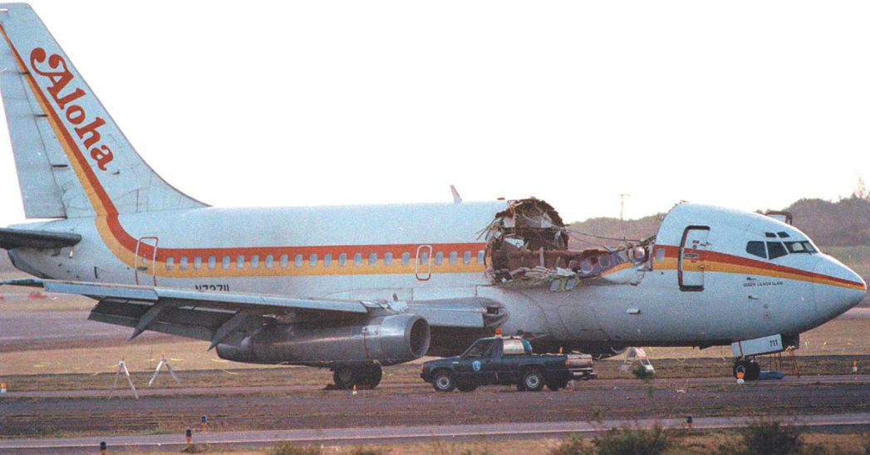
Failure Examples
Thermal cycling
Cyclic stress, low temperature
Cyclic stress, corrosive environments
Failure could occur lower than TS (σ_{TS}) and YS (σ_{y}) measured by tensile test

Slide 15
Failure Types and Tests
Failures
  Normal (simple) fracture
    Tensile test: σ-ε curve
  Fatigue
    Fatigue test: S-N curve
  Creep
    Creep test: ε-t curve
  Stress-corrosion cracking
  Other tests
    Fracture toughness test
    Impact energy test
Types | Stress condition | Temperature | Typical test
Normal fracture | Static (constant or slowly changing w/ time) | Room temperature (RT) | Tensile test
Fatigue | Dynamic (cyclic w/ time) | RT | Fatigue test
Creep | Static | High | Creep test

Slide 16
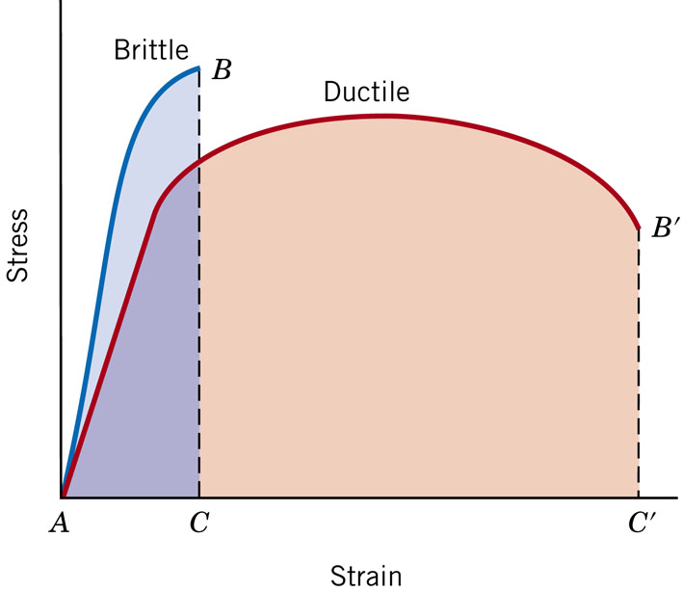
Ductile and Brittle Fracture (Simple Fracture)
Fracture mode
  Ductile fracture
    Substantial plastic deformation before fracture
  Brittle fracture
    Little (or no) plastic deformation before fracture
Ductile vs. Brittle fracture
  Materials
    Metal: usually ductile
    Ceramic: brittle
  Material state
    More brittle w/ flaw in materials
  Temperature
    More brittle w/ low temperature
  Strain rate
    More brittle w/ higher strain rate
σ
σ

Slide 17
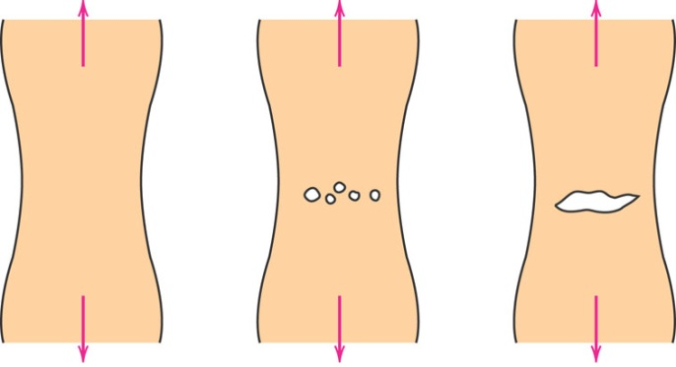
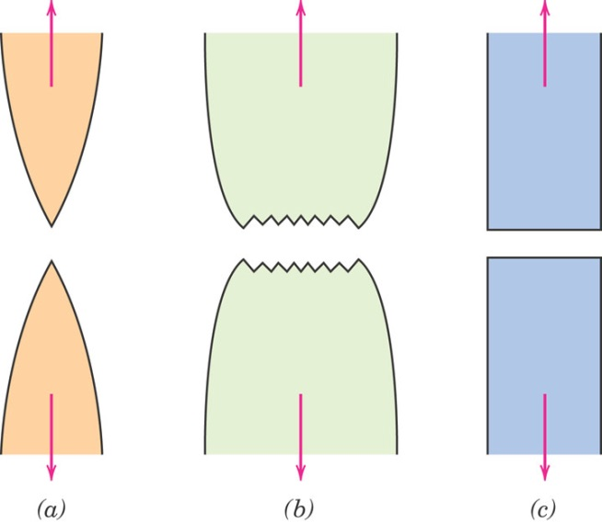
Fracture Mechanism and Fracture Mode
Crack formation and propagation
Fracture process
  Crack formation
  Crack propagation
Fracture mode
  Dependent on crack propagation
  Ductile fracture
    Slow crack propagation
    Additional stress and deformation required for crack propagation
  Brittle fracture
    Rapid crack propagation
Ductile fracture is preferred
  Slow process
  Usually with warning
  More strain energy required for fracture
Highly ductile fracture (gold, lead at RT)
moderately ductile fracture (many metal)
Brittle fracture

Slide 18
Fatigue
Fatigue
  A form of failure (lower than normal failure stress)
  Failure under applied cyclic stress
    Stress condition: dynamic and fluctuating (time-dependent stress)
    Temperature: relatively low
  Why important
    Failure could occur at stress level considerably lower than TS or YS for a static load (σ_{max} < σ_{y})
    Occurs catastrophically (suddenly and no warning)
    ~90% of metallic failures
    Polymers and ceramics also susceptible

Slide 19
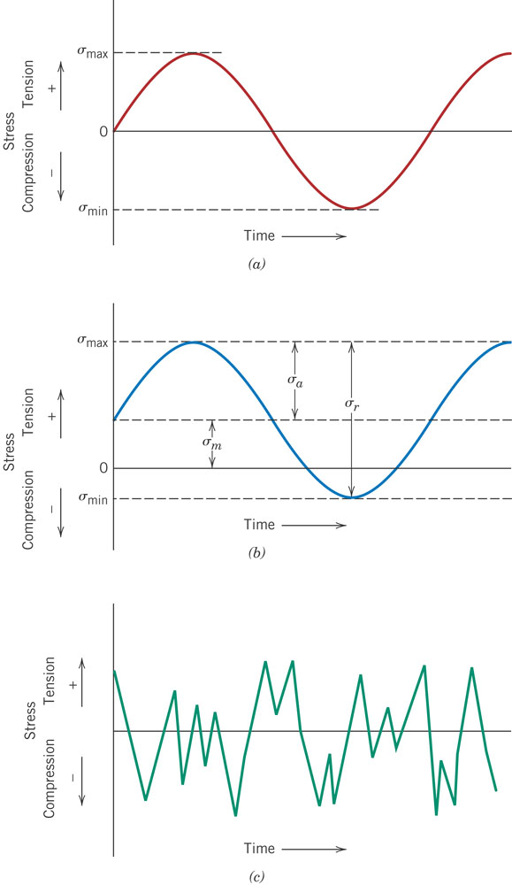
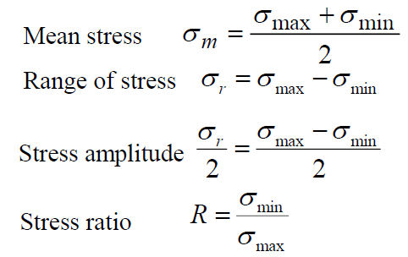
Stress Conditions in Fatigue
Applying cyclic stress conditions
  Tensile (+) compressive (-)
  Reversed stress cycle
  Repeated stress cycle

Slide 20
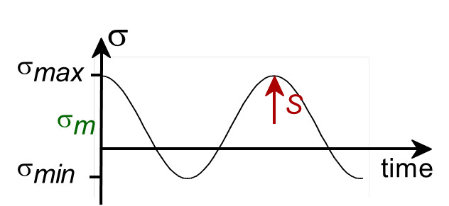
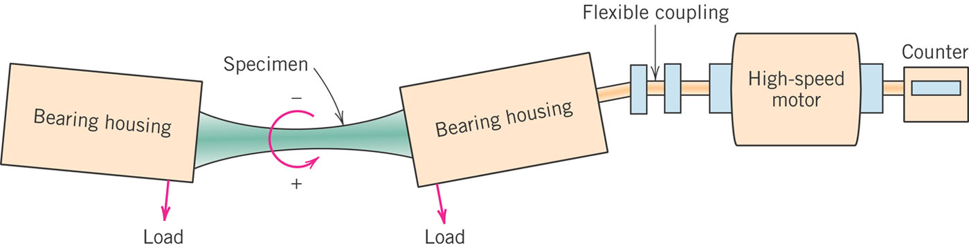
Fatigue Test
Typical fatigue test
  Simulating service stress conditions
    Uniaxial tension-compression test
    Rotating-bending test
  S-N curve
    S: stress amplitude
    N: # of cycle to failure

Slide 21
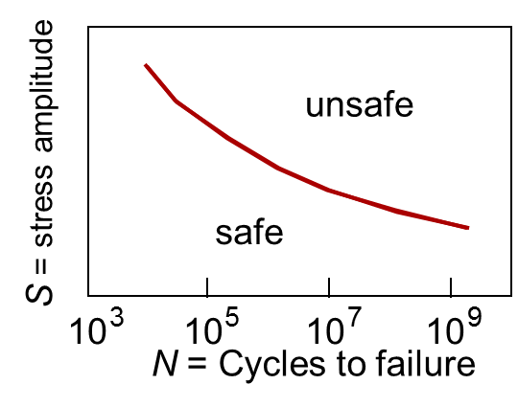
S-N Curve I
S (stress amplitude) ↑ ⇒ early failure ⇒ N (# of cycle to failure) ↓
  Elastic and plastic deformation
    Smaller N for failure Low-cycle fatigue
  Elastic deformation only
    Larger N for failure High-cycle fatigue

Slide 22
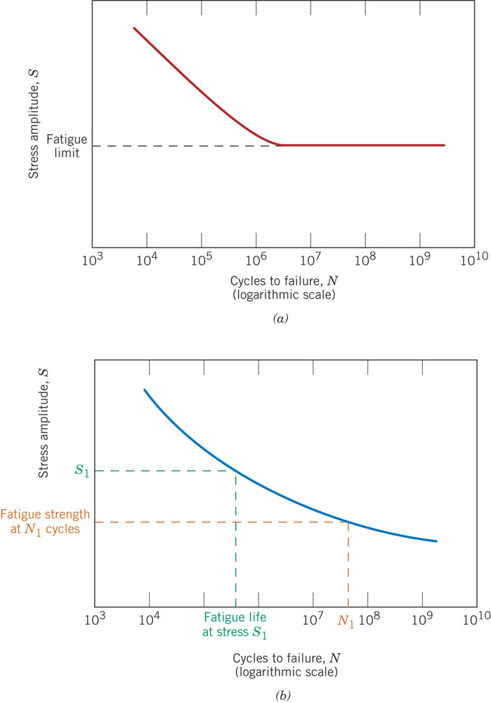
S-N Curve II
Lower S with increasing N but no failure if S lower than certain value
  Ferrous and Ti alloys
  S becomes constant after certain N
Fatigue limit
  Failure will not occur below the limit
  Usually 35-60% of TS for steels
S-N curve type 1 (w/ fatigue limit)

Slide 23
S-N Curve III
Continuously lower S with increasing N
  Non-ferrous alloys (Al, C, Mg, etc.)
  No fatigue limit
Fatigue strength
  Stress level at which failure occurs for specified # of cycles
Fatigue life
  # of cycles to cause failure at specified stress level
S-N curve type 2 (w/o fatigue limit)

Slide 24
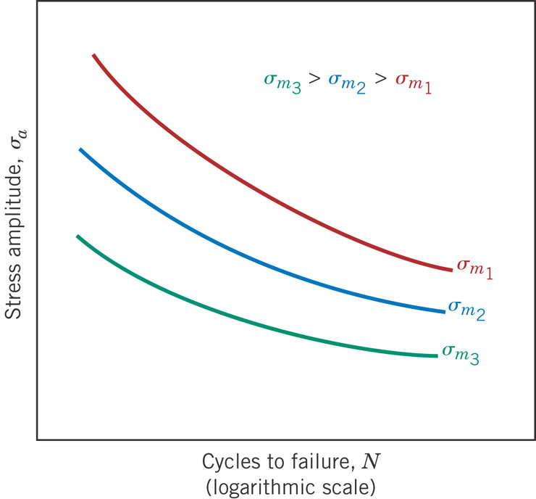
Factors Affecting Fatigue Life I
Environments
  Thermal fatigue
  Corrosion fatigue
Mean stress
  σ_{m}↑ → N↓ even w/ same S

Slide 25
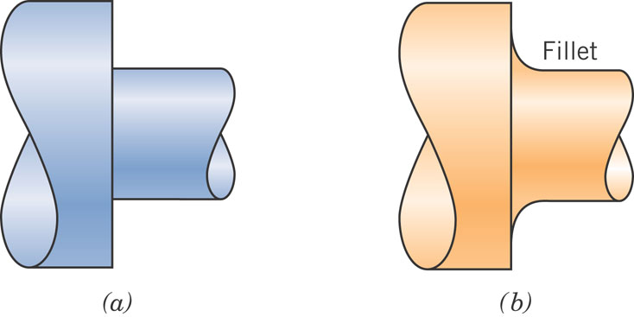
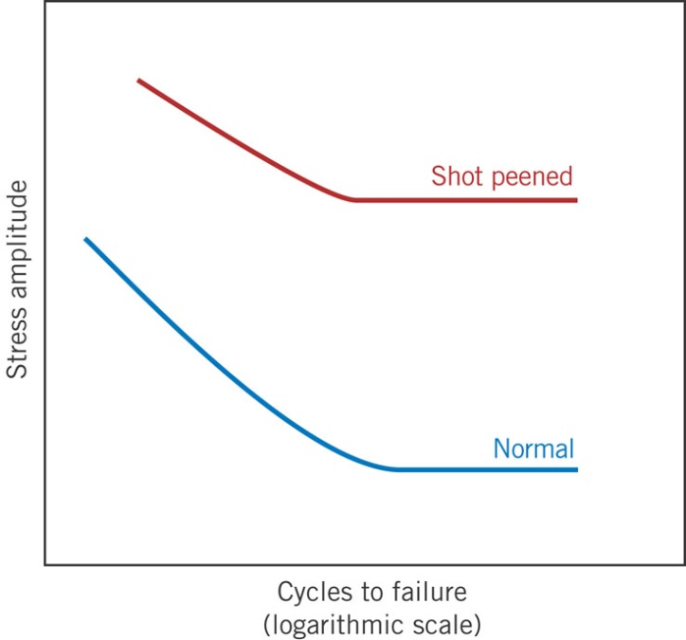
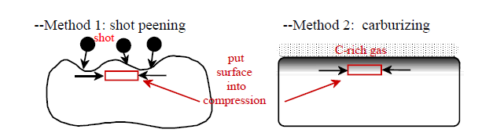
Factors Affecting Fatigue Life II
Surface
  Crack initiation usually on surface
  Surface condition
  Surface configuration
  Improve fatigue life
    Design
      Avoid or minimize stress concentrator
    Surface treatment
      Imposing residual compressive stress near surface
        Shot peening
        Case hardening

Slide 26
Recommended Reading
W. D. Callister and D. G. Rethwisch, Materials Science and Engineering An Introduction
  Chapter 6.1-6.9 (Tensile)
  Chapter 8.1-8.4 (Fracture)
  Chapter 8.7-8.10 (Fatigue)

